Slide 1
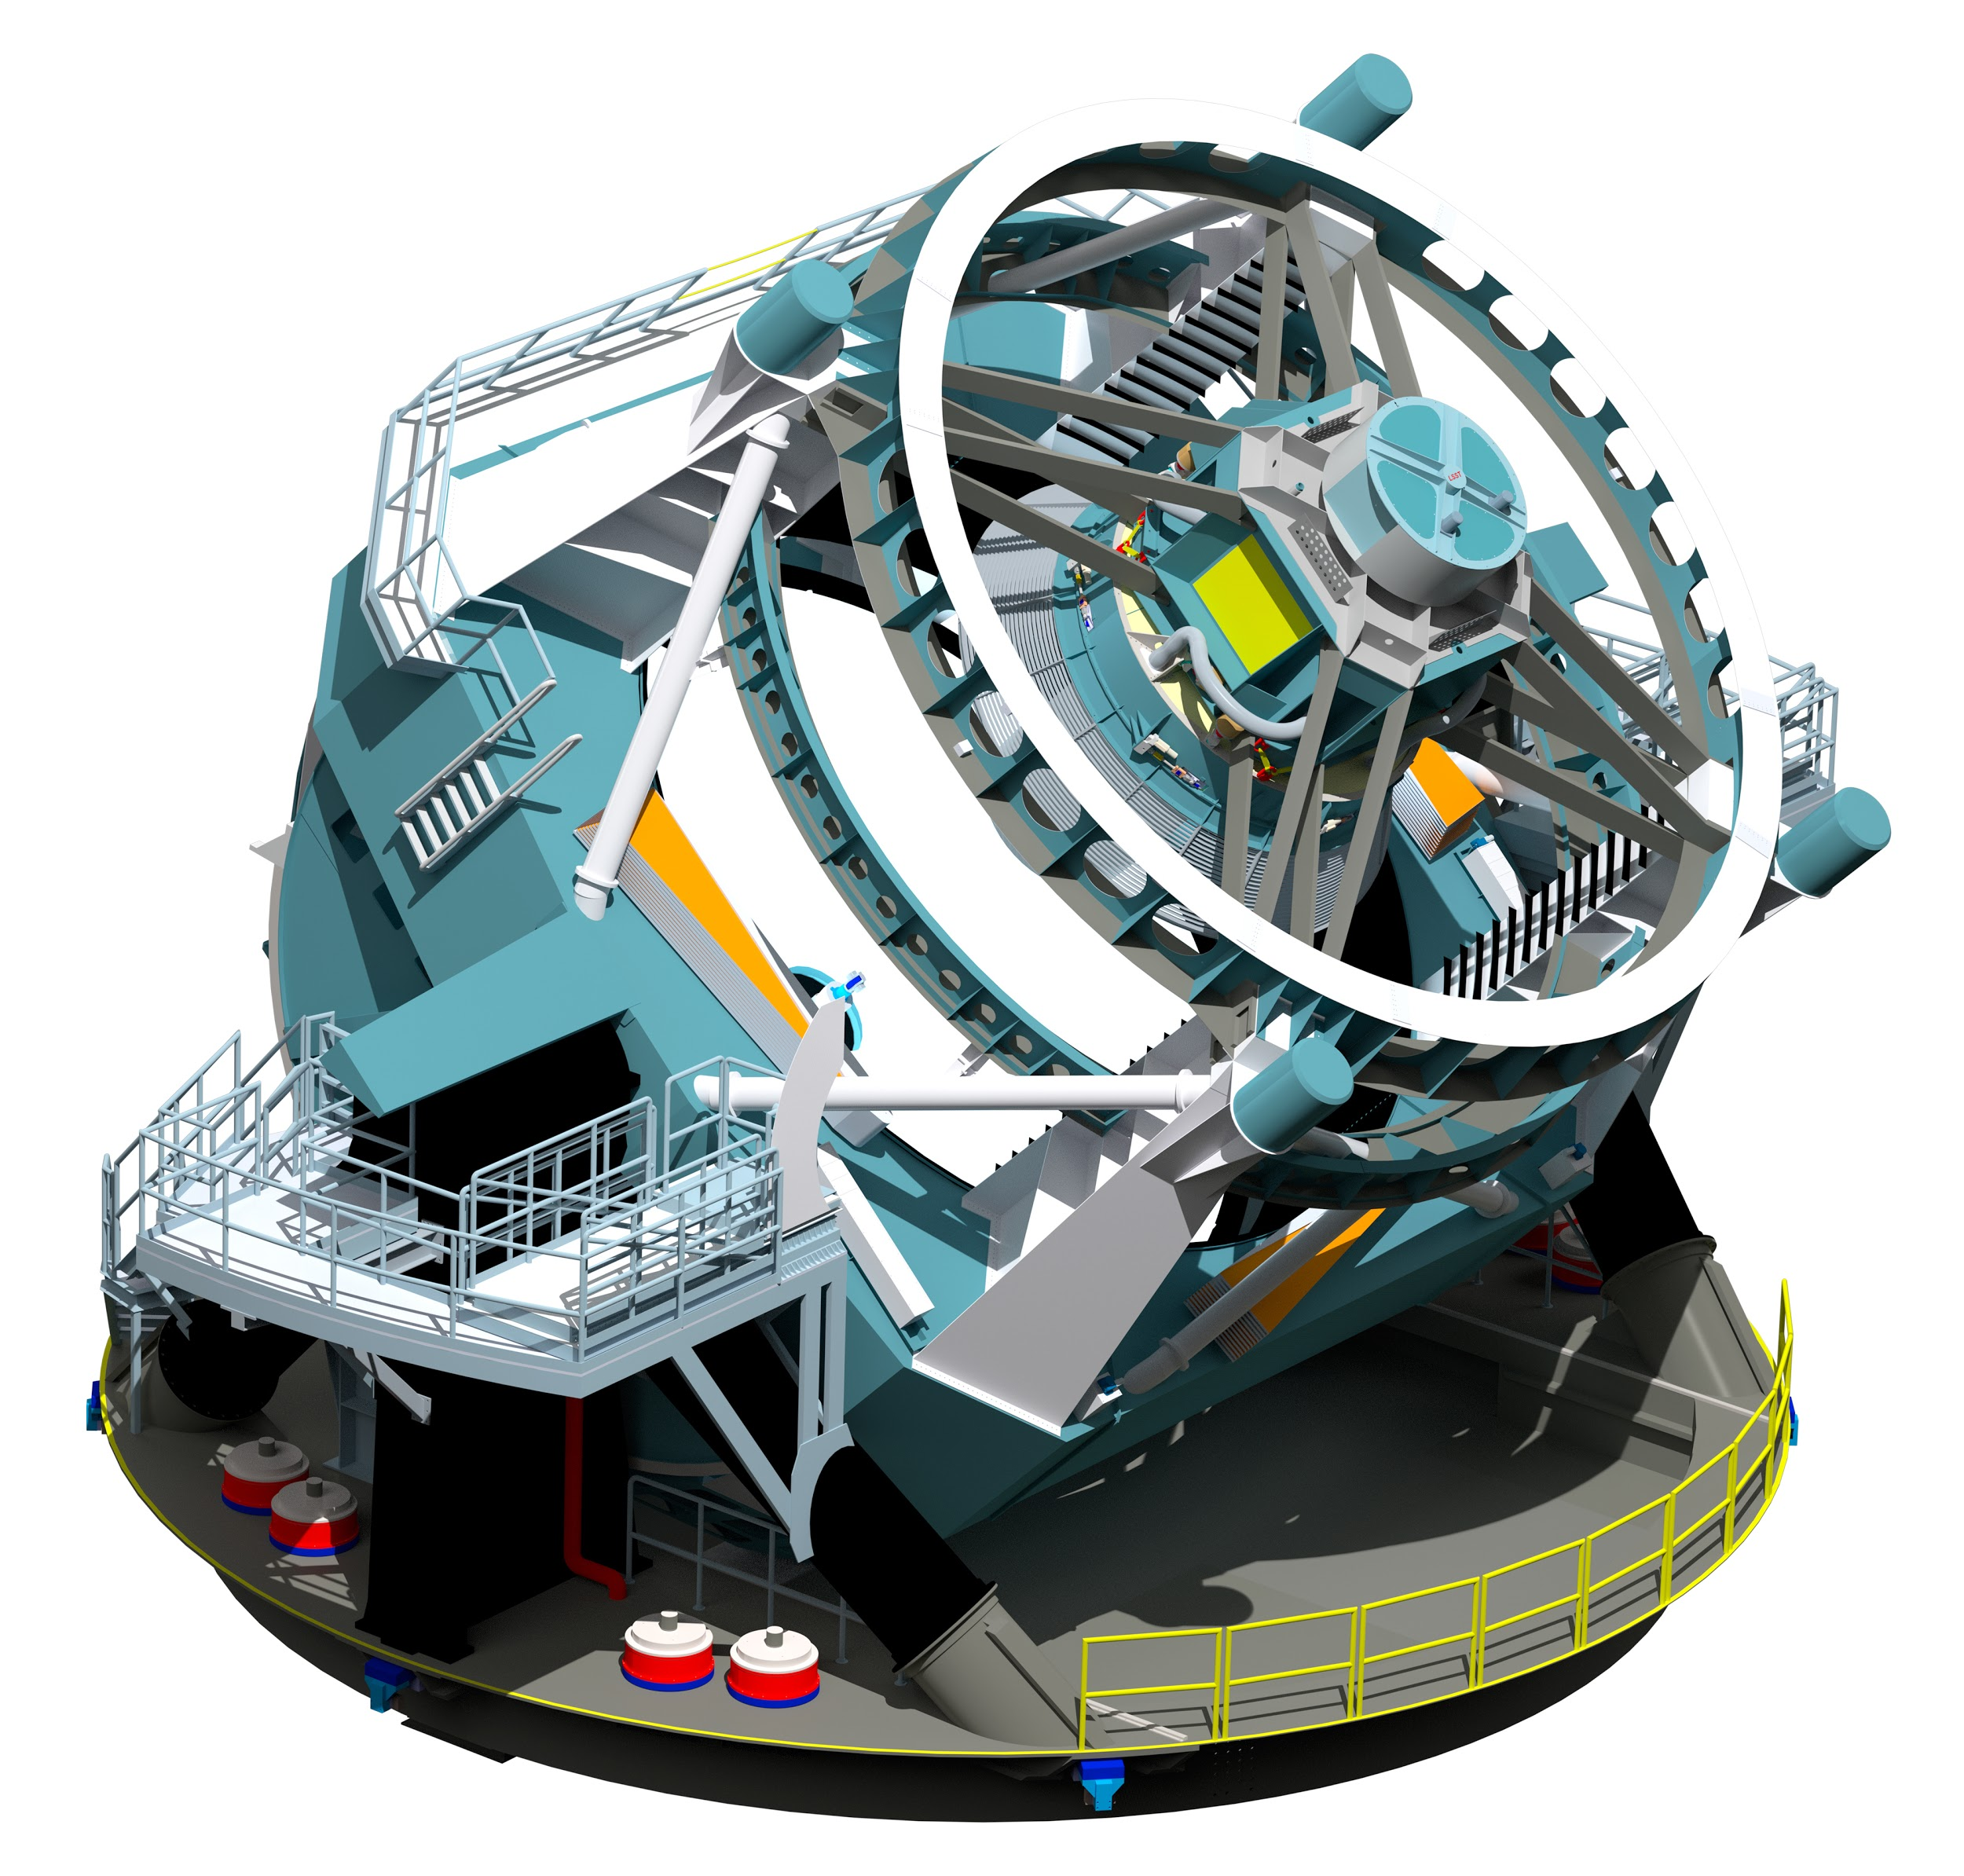
(Beyond) LSST’s Moving Object
Processing System (MOPS)
What is Joachim up to?
The thing that keeps
Mario up at night
DIRAC Solar System Group
DIRAC - Lunch Seminar - October 08 2018

Slide 2
(Beyond) LSST’s Moving Object
Processing System (MOPS)
What is Joachim up to?
The thing that keeps
Mario up at night
DIRAC Solar System Group
DIRAC - Lunch Seminar - October 08 2018
Notes:
Thank you for inviting me, pleasure of seeing a talk about the result from the FDL session in 2016. So its a pleasure to be invited to talk to you.
Introduce myself: graduate student, UW, LSST for 3 years: calibration and then NEOS / asteroids

Slide 3
(Beyond) LSST’s Moving Object
Processing System (MOPS)
What is Joachim up to?
The thing that keeps
Mario up at night
DIRAC Solar System Group
DIRAC - Lunch Seminar - October 08 2018
Notes:
Thank you for inviting me, pleasure of seeing a talk about the result from the FDL session in 2016. So its a pleasure to be invited to talk to you.
Introduce myself: graduate student, UW, LSST for 3 years: calibration and then NEOS / asteroids

Slide 4
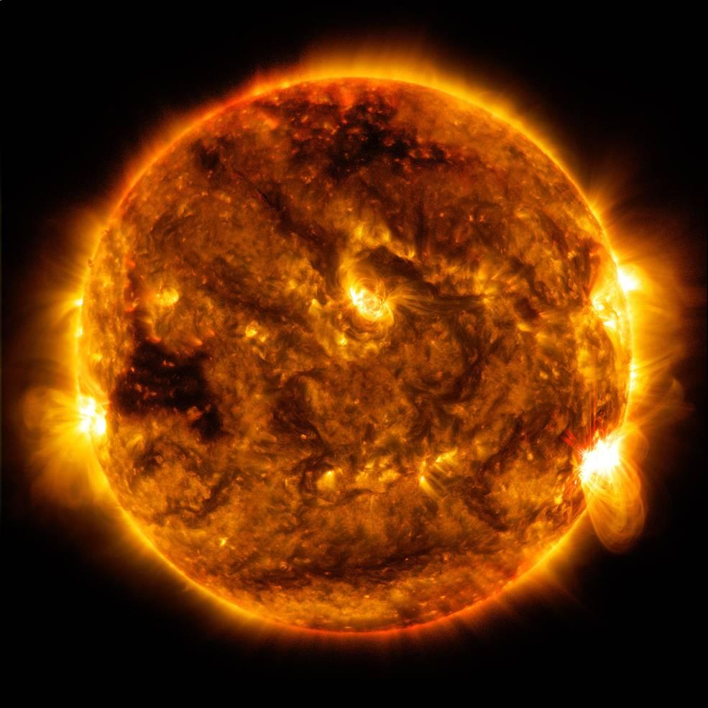
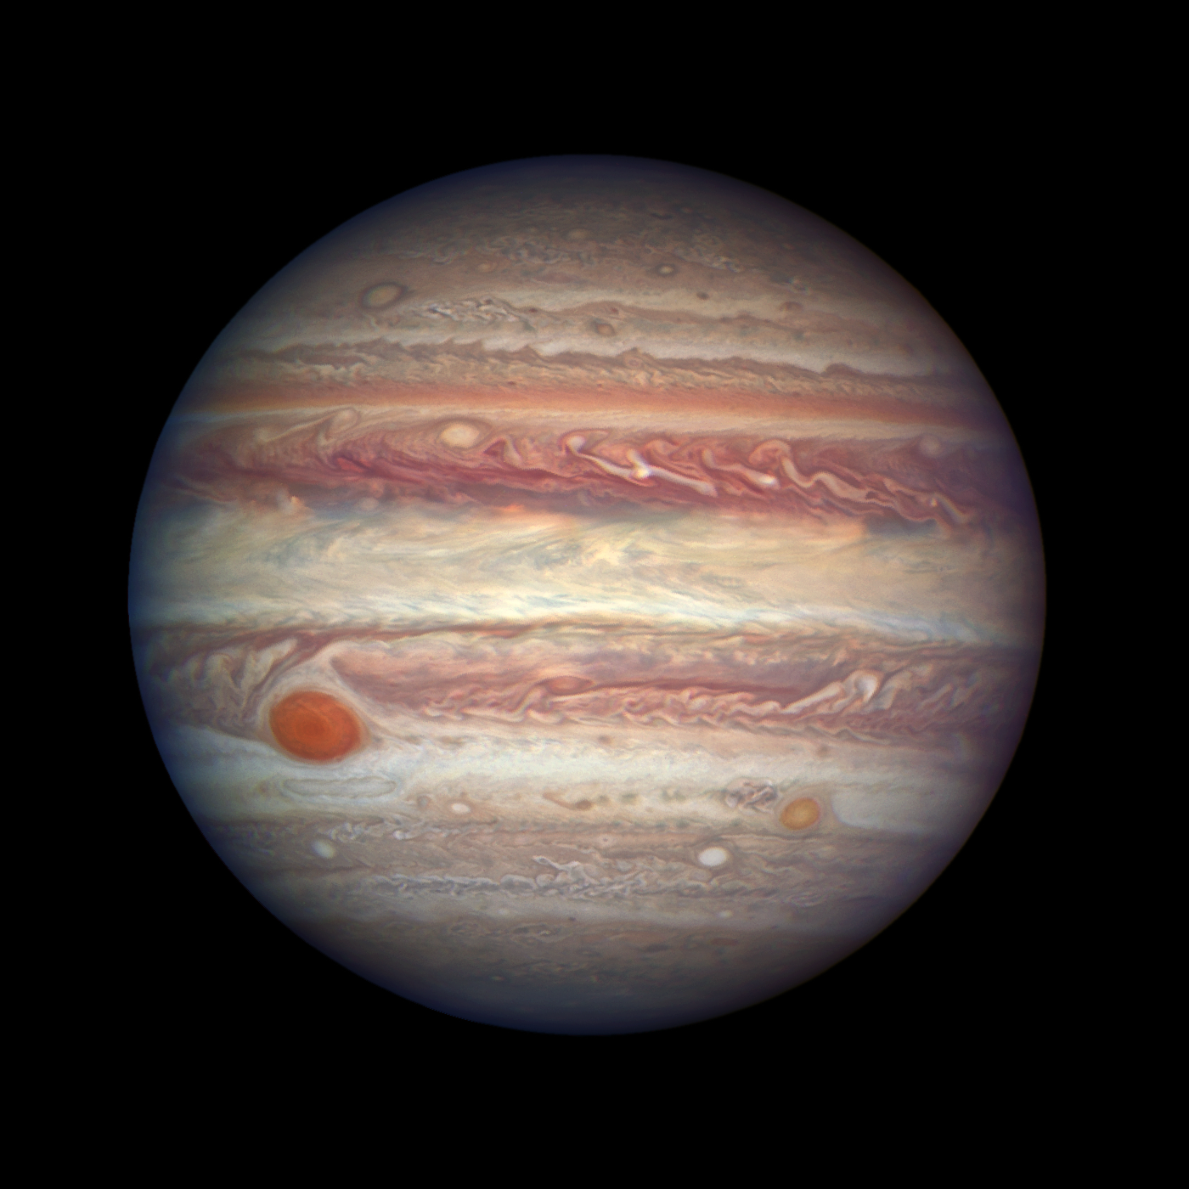
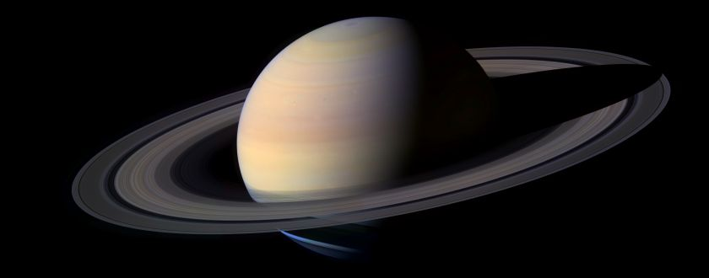
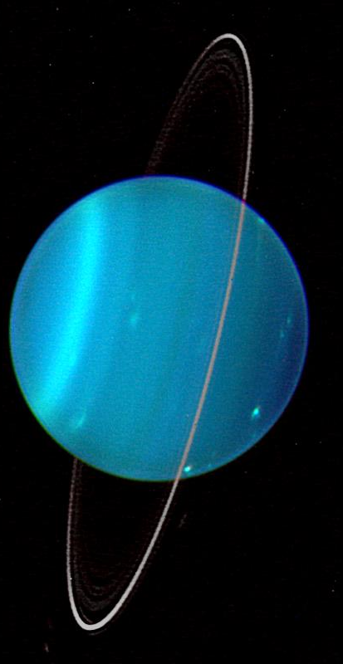
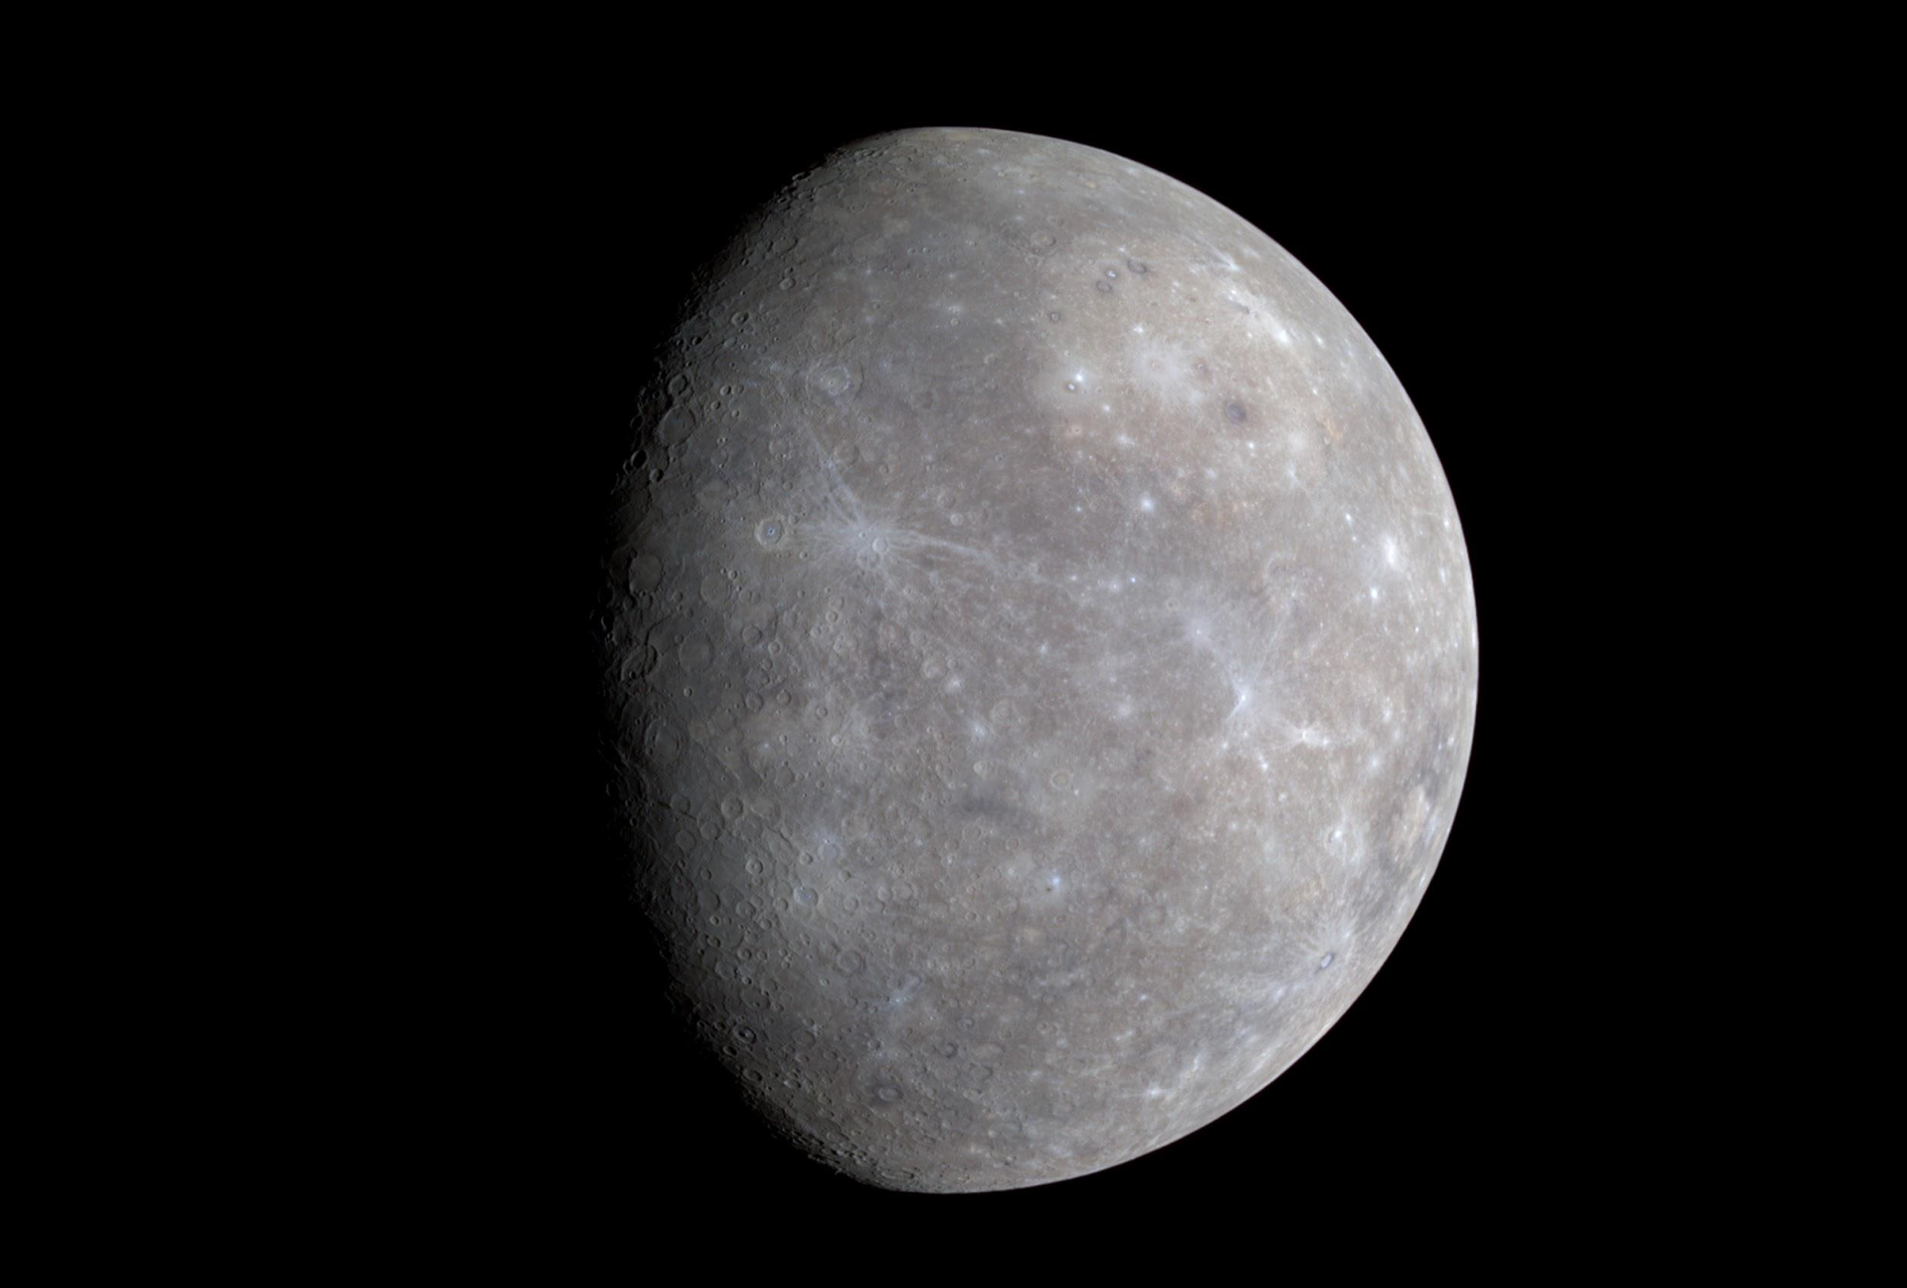
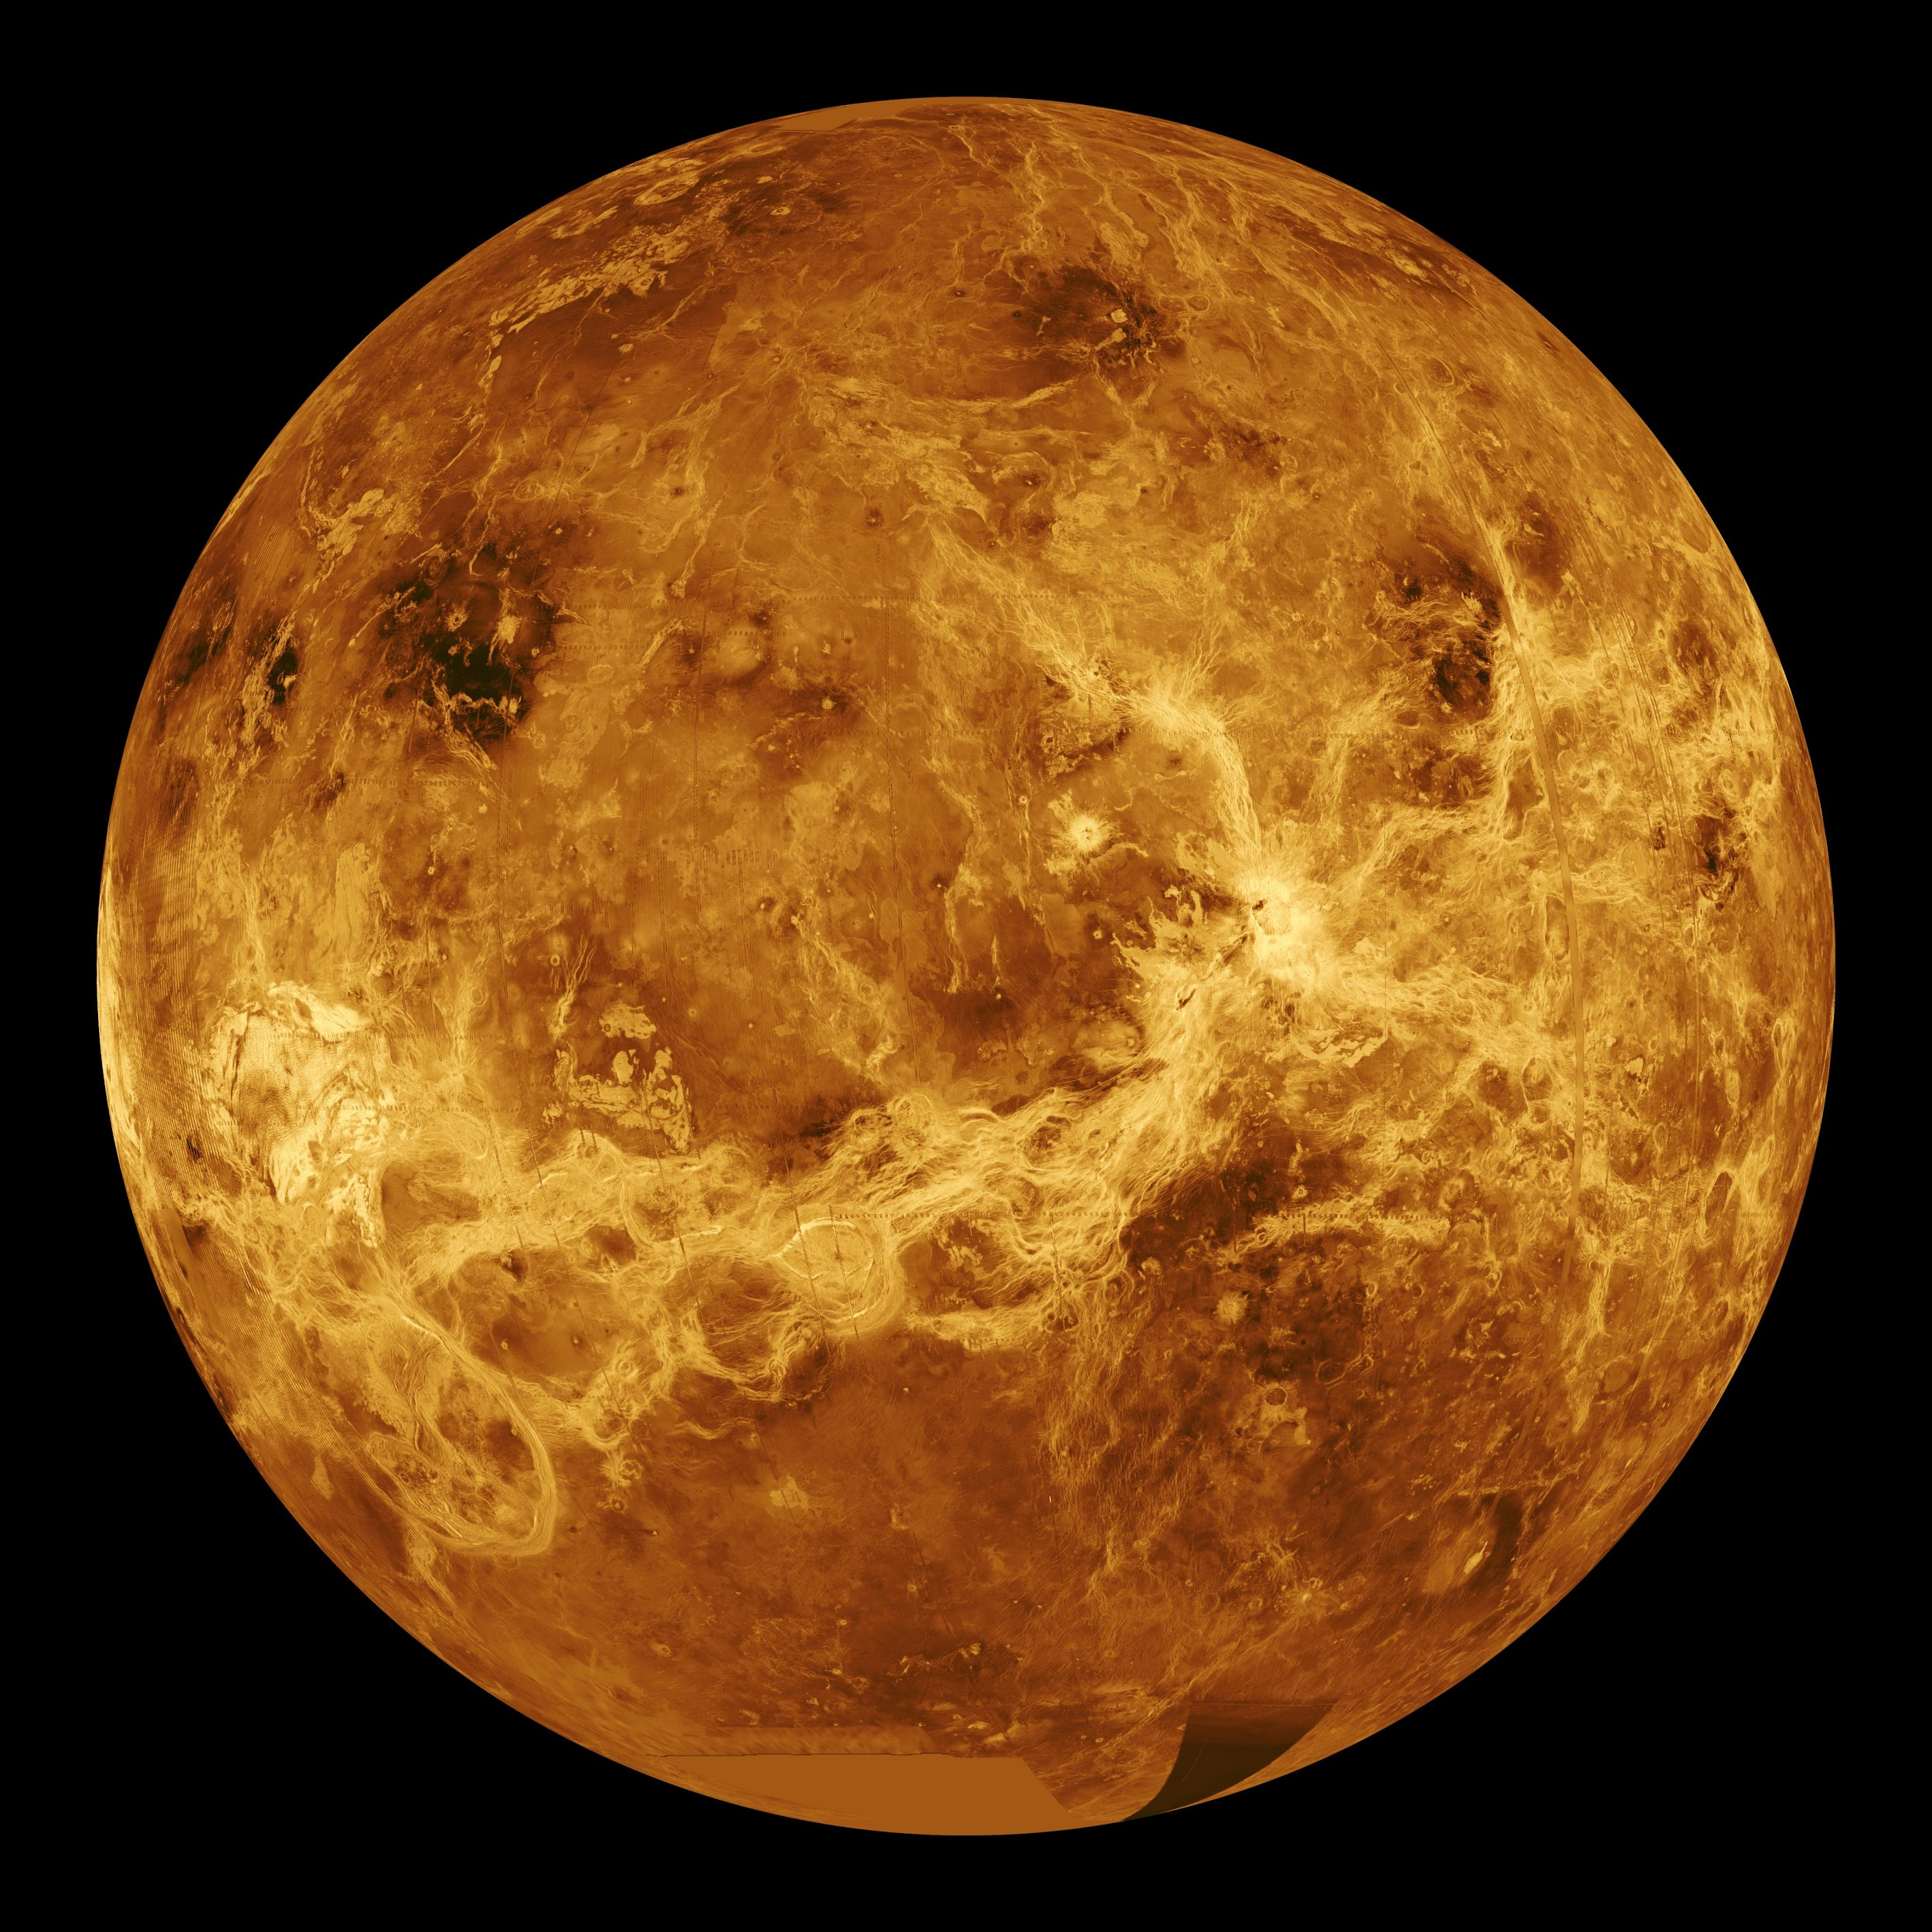

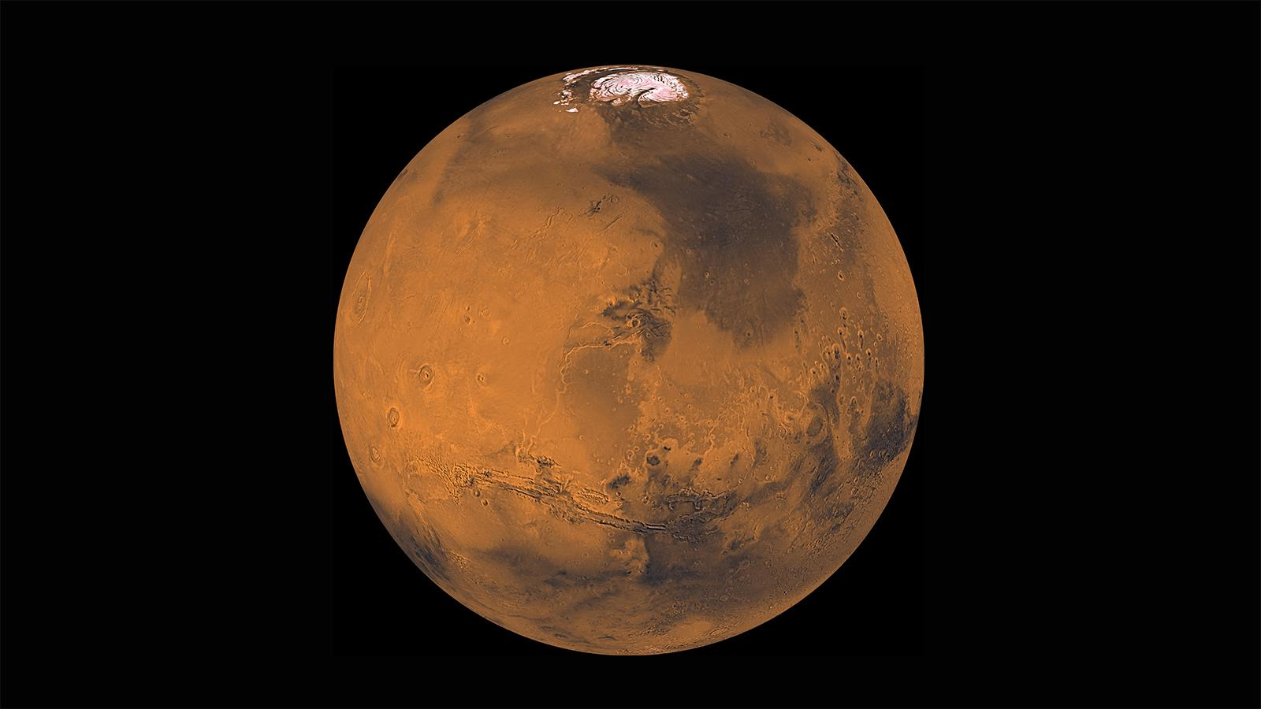
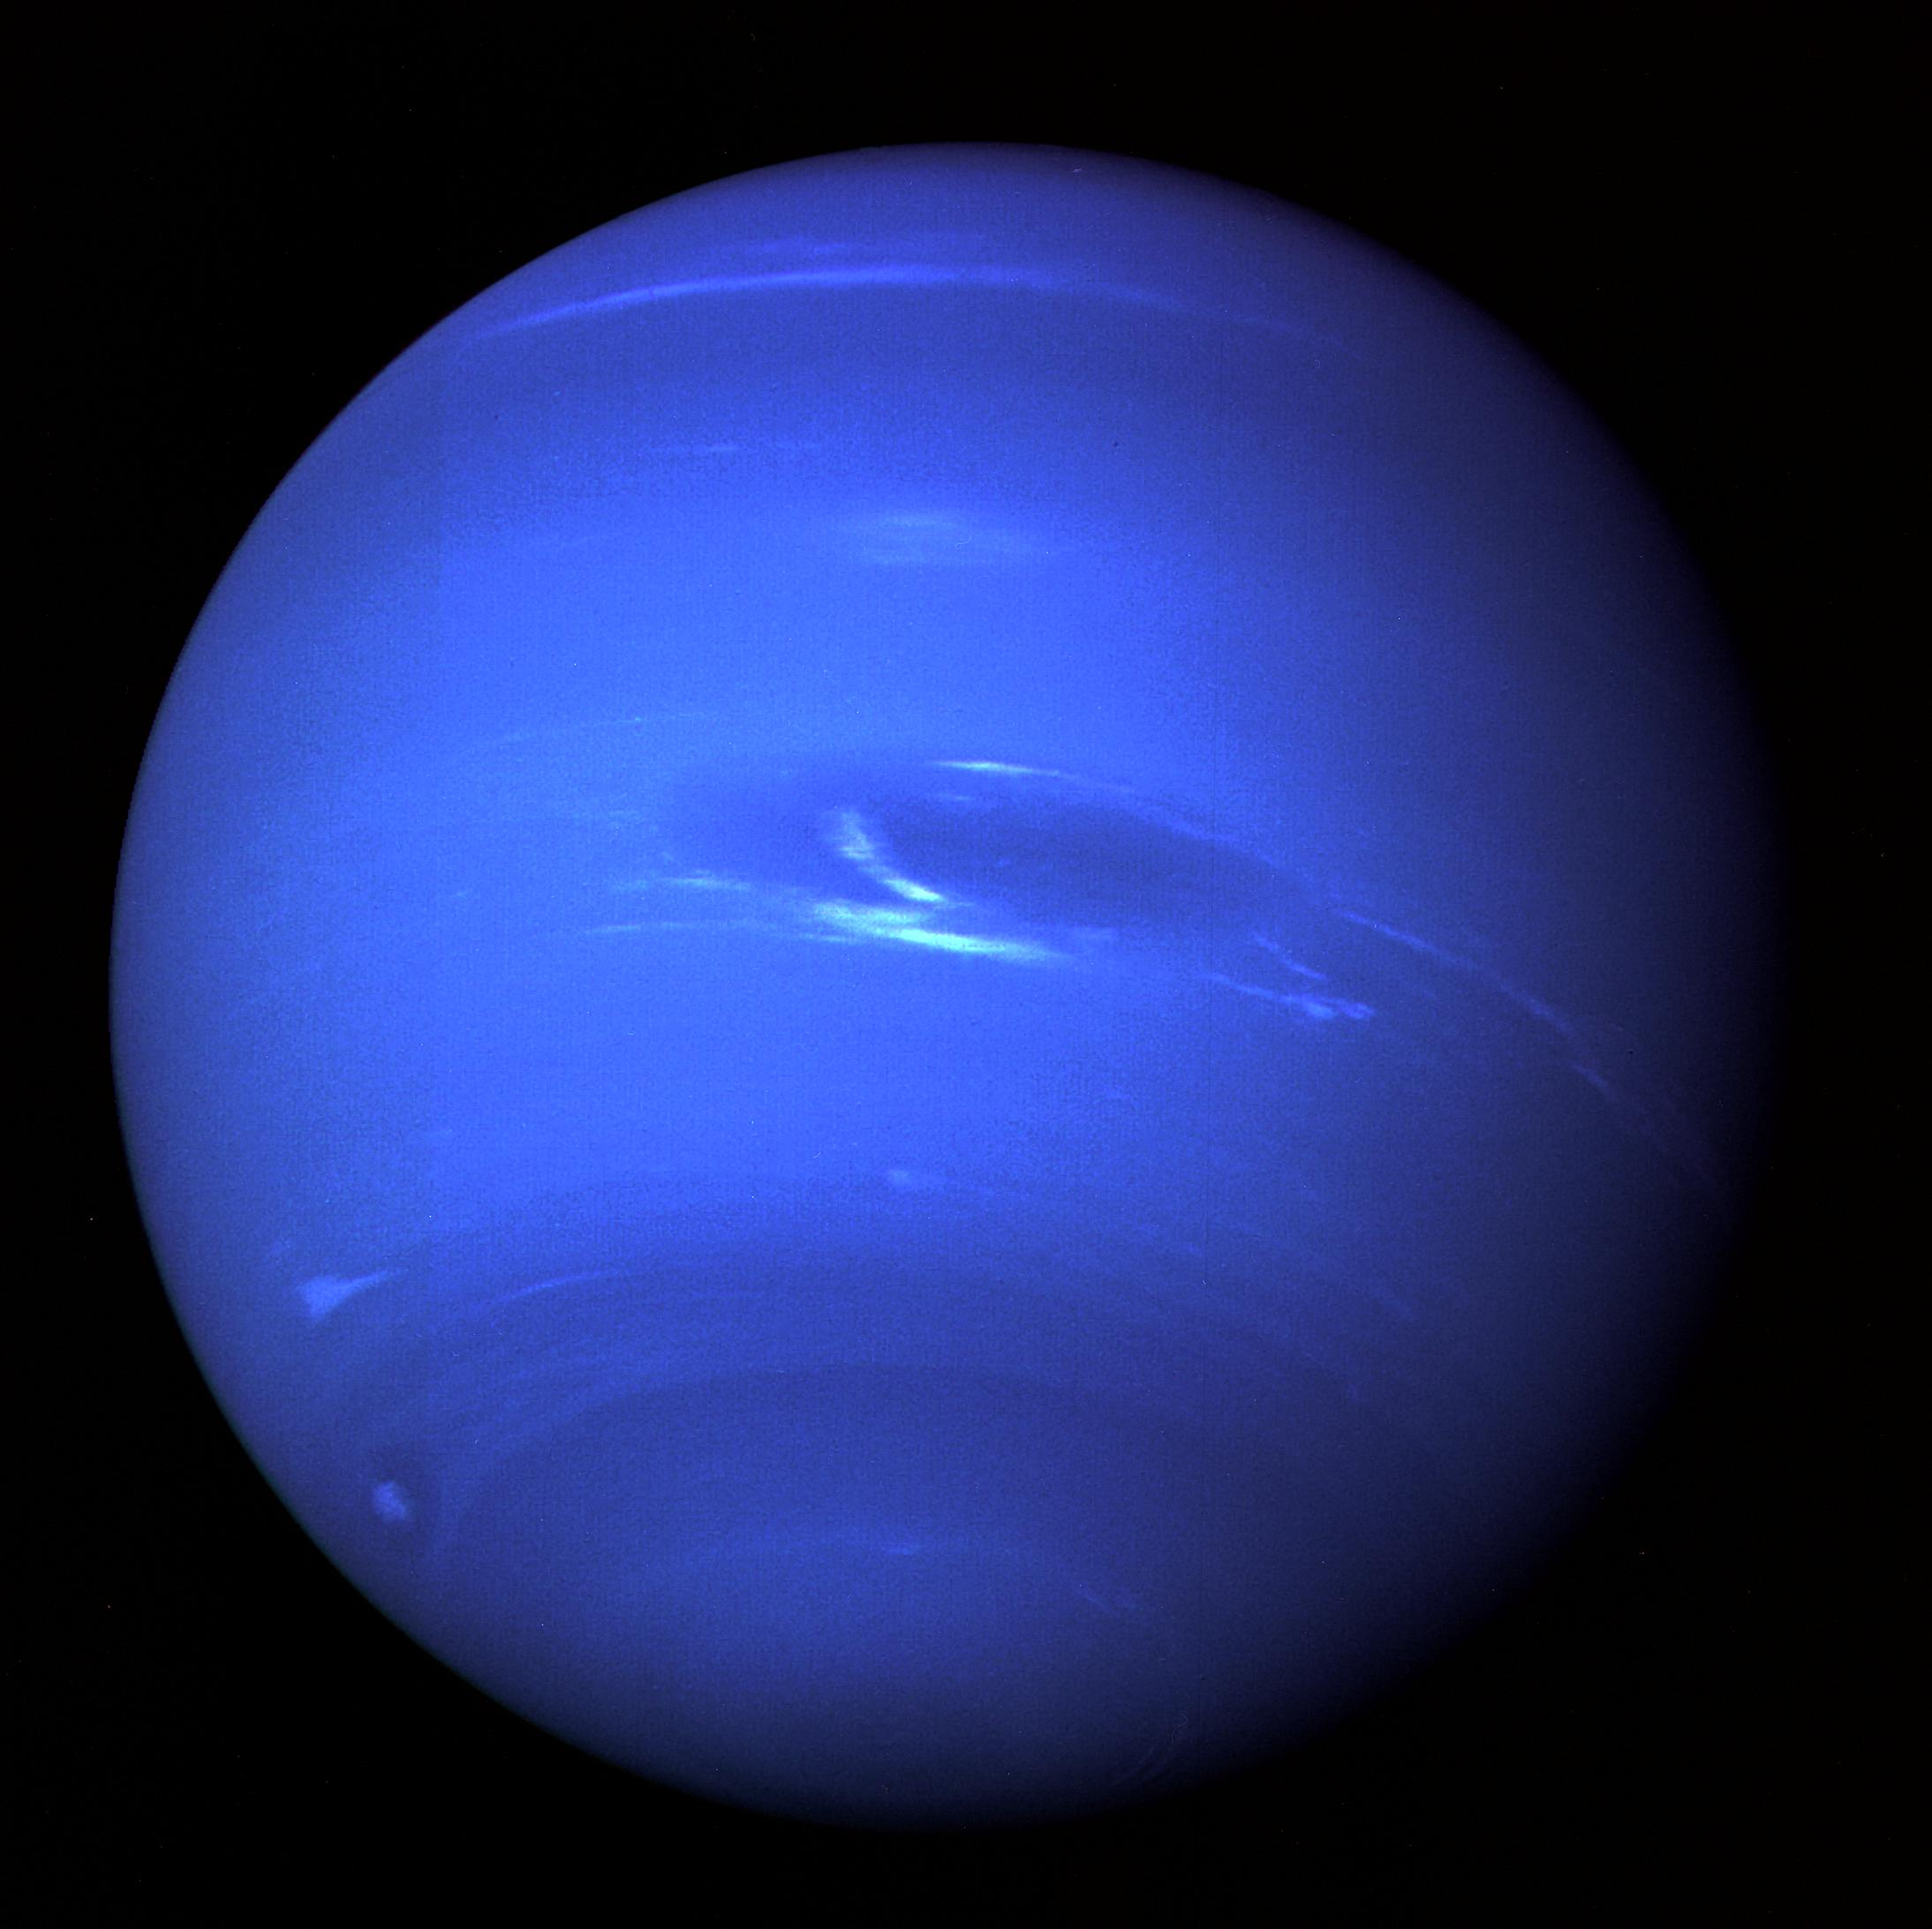
Enabling Solar System Science with LSST
Near-Earth Asteroids
~ 18,000
Jupiter Trojans
~ 6,000
Main Belt Asteroids
~ 760,000
Trans-Neptunian Objects and beyond
~ 2,000

Slide 5
Enabling Solar System Science with LSST
Near-Earth Asteroids
~ 18,000
Jupiter Trojans
~ 6,000
5x
40x
> 100,000
> 280,000
Main Belt Asteroids
~ 760,000
Trans-Neptunian Objects and beyond
~ 2,000
8x
20x
> 5,500,000
> 40,000

Slide 6
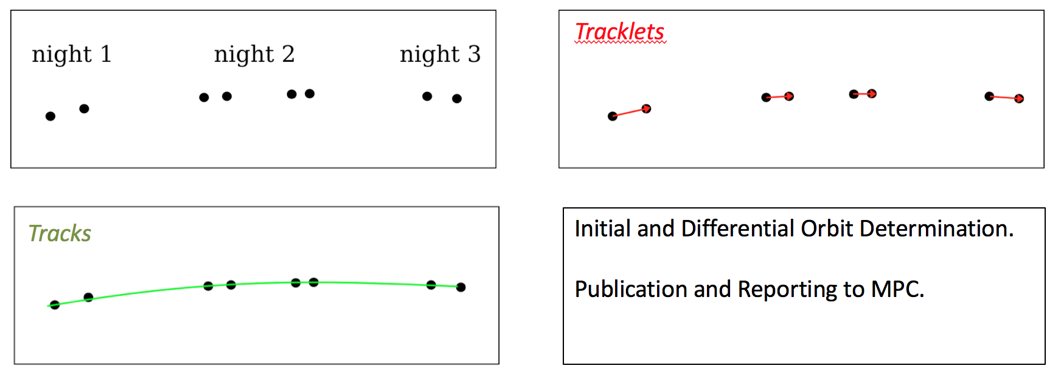
Moving Object Processing System
Tracklets: Intra-night linkages of difference image detections (linear fit with maximum and minimum velocity)
Tracks: Inter-night linkages of tracklets (quadratic fit over sky-plane projection)
(See: Kubica et al. 2007, Denneau et al. 2007)
Notes:
•tracklets: potential linkages in the same night (linear extrapolation)
•tracks: potential linkages over three nights (quadratic fit)
•reportable discovery: a track that unambiguously fits a Keplerian orbit within the astrometric uncertainties
•MOPS: the software system that links detections into reportable discoveries

Slide 7
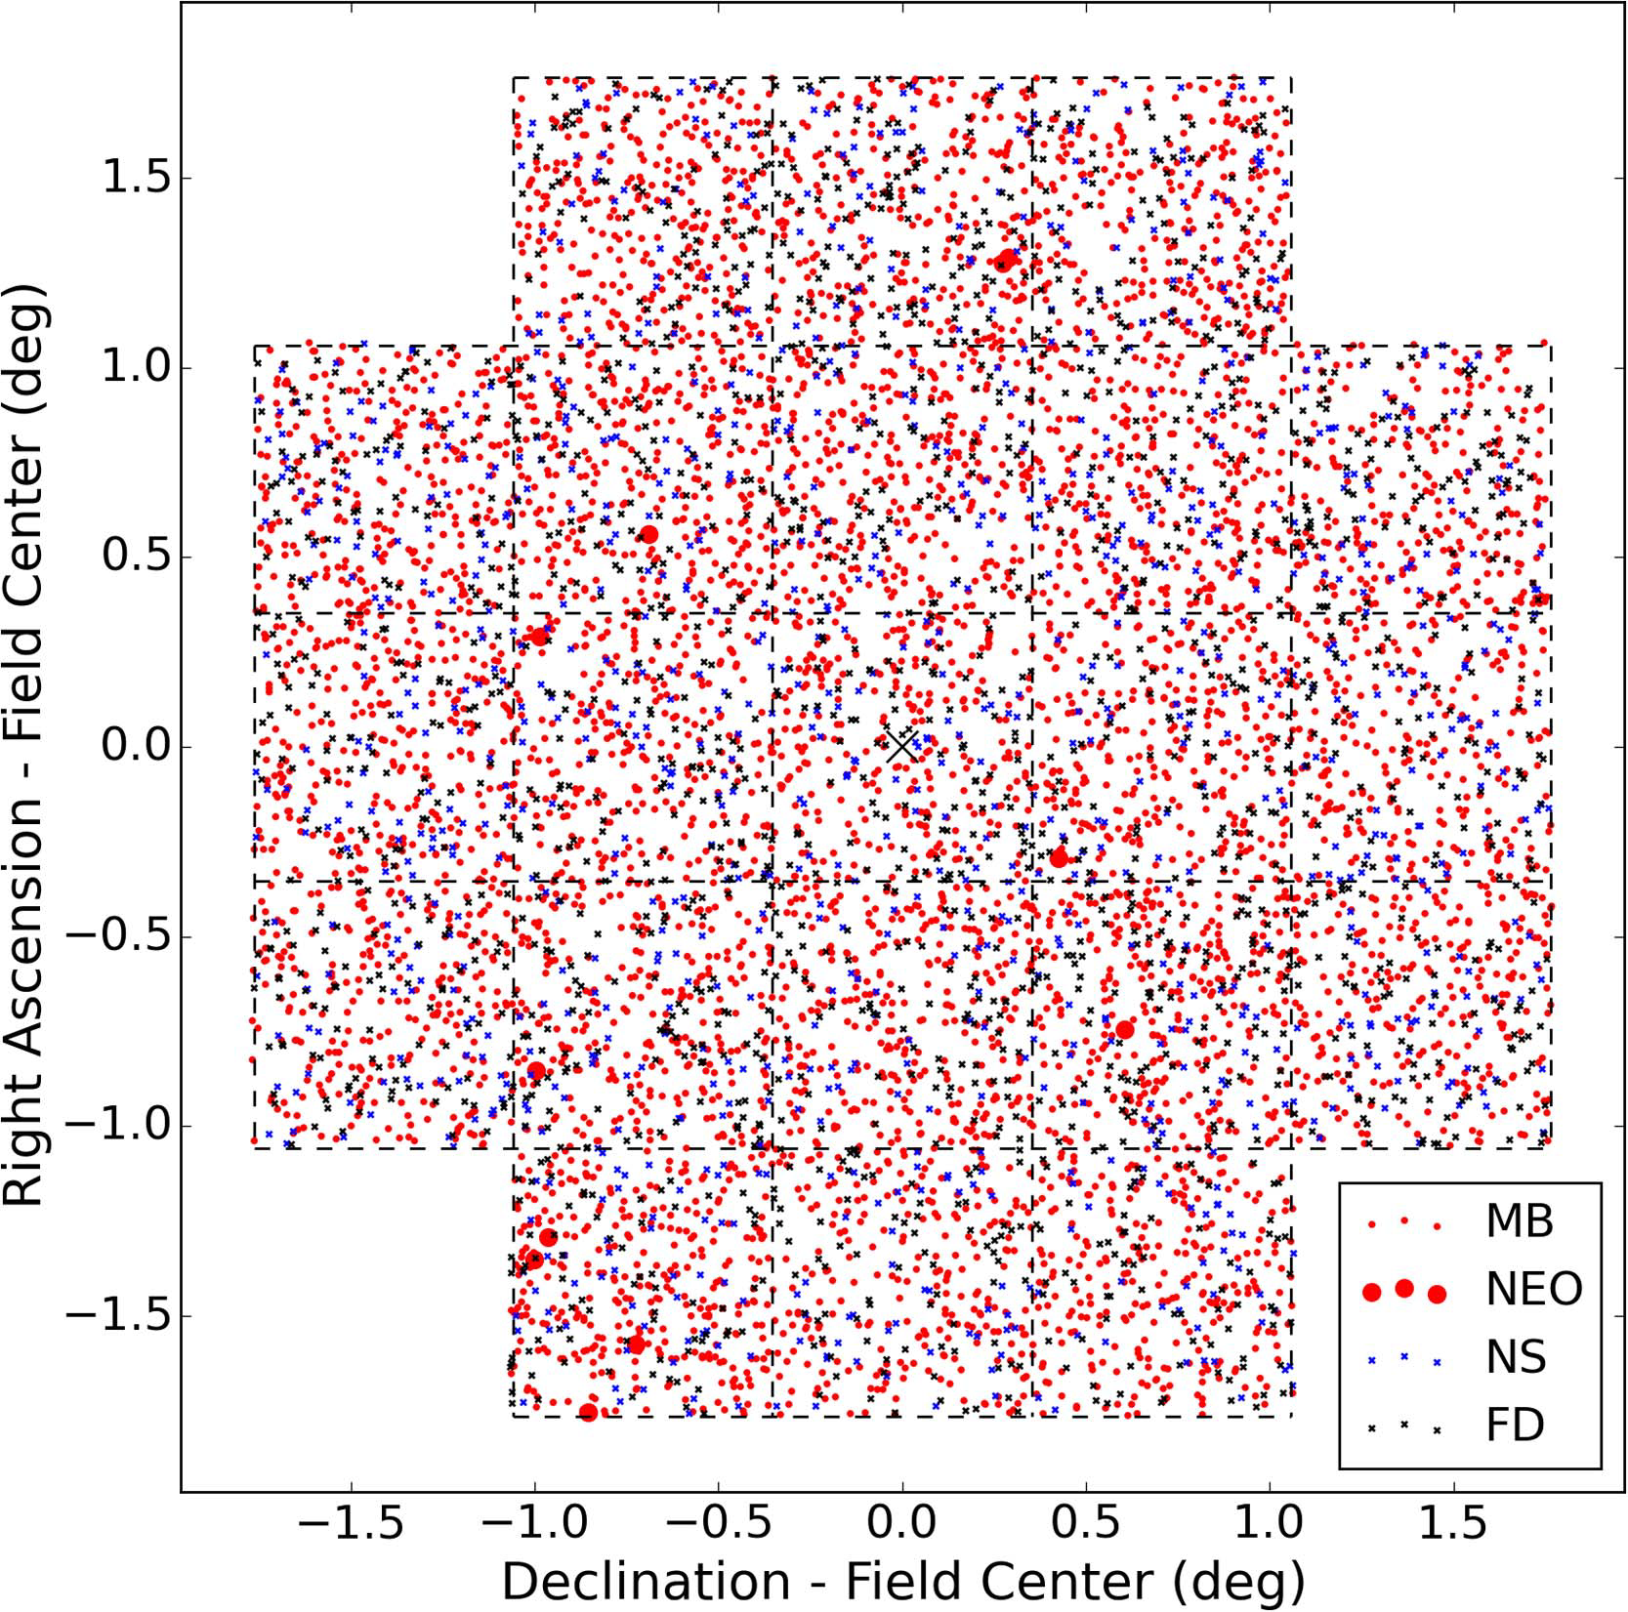
Moving Object Processing System
(See: Veres & Chesley 2017)
17

Slide 8
Moving Object Processing System
~ 1000 visits a night!
18

Slide 9
Moving Object Processing System
Tracklets: Intra-night linkages of difference image detections (linear fit with maximum and minimum velocity)
Tracks: Inter-night linkages of tracklets (quadratic fit over sky-plane projection)
(See: Kubica et al. 2007, Denneau et al. 2007)

Slide 10
Beyond MOPS?

Slide 11
Beyond MOPS?
?

Slide 12
Beyond MOPS?
We can guess this.
?

Slide 13
Tracklet-less Heliocentric Orbit Recovery

Slide 14
Tracklet-less Heliocentric Orbit Recovery
heliocentric distance, r
cartesian velocity, v

Slide 15
Tracklet-less Heliocentric Orbit Recovery

Slide 16
Tracklet-less Heliocentric Orbit Recovery

Slide 17
Tracklet-less Heliocentric Orbit Recovery

Slide 18
Tracklet-less Heliocentric Orbit Recovery
range
shift

